Slide 1
CSCI 1130
Introduction to Computing
Using Java
Tutorial 11

Slide 2
Topics
Assignment 6
  BoardGame Connect4
Final Revision
  OOP Understanding
  Array and Reference

Slide 3
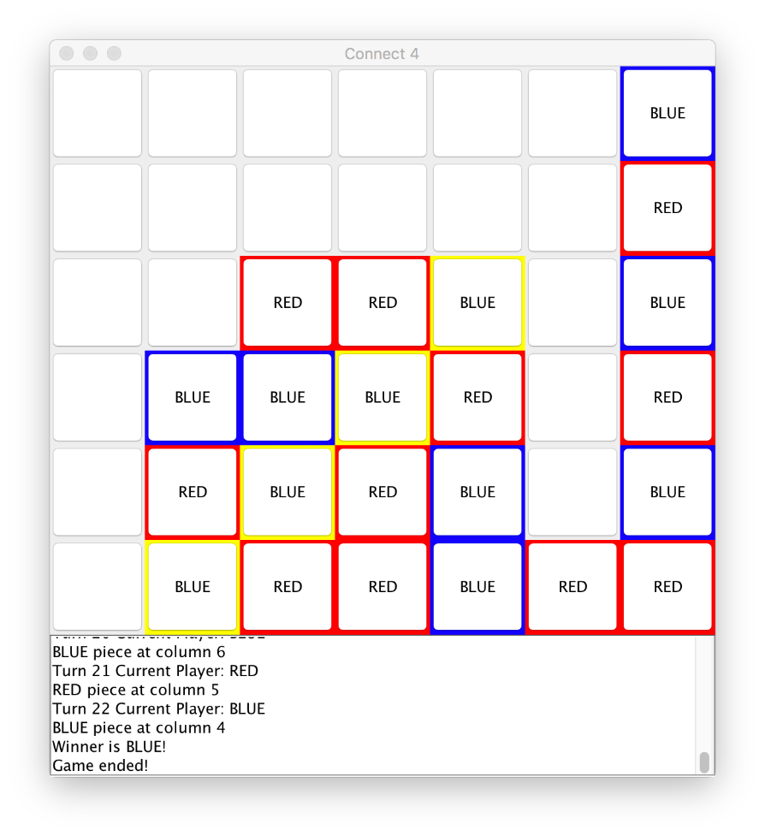
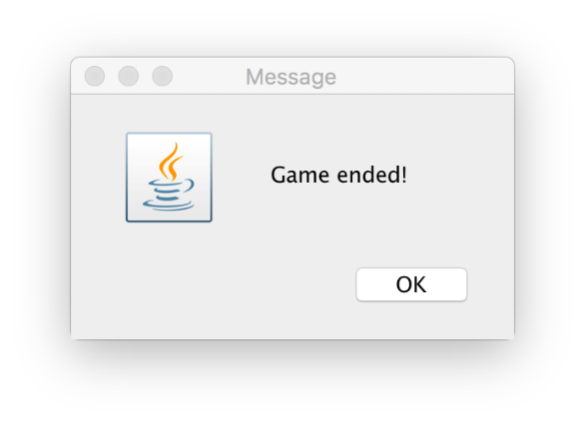
Assignment 6 BoardGame
Connect4
Rules:
The board size: 7 columns by 6 rows;
Two players: RED and BLUE;
Place one piece at a time on an initially empty board in turns.
RED always plays first.
BLUE wins on MacOS

Slide 4
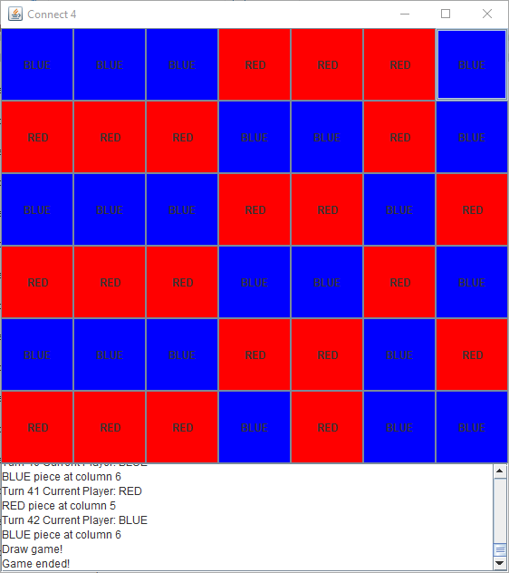
Assignment 6 BoardGame
Connect4
How to win:
Whoever can get 4 consecutive pieces on a straight line (horizontal, vertical or diagonal) wins.
If there is no vacancy and no one wins, it is a Draw game.
Draw game on Windows

Slide 5
Assignment 6 BoardGame
Connect4
Remarks:
Due to gravity, a newly placed piece will always "drop" and sit on top of existing pieces or to the bottom of a column.
The application shall highlight 4 winning pieces in YELLOW and end the game.
BLUE wins on MacOS

Slide 6
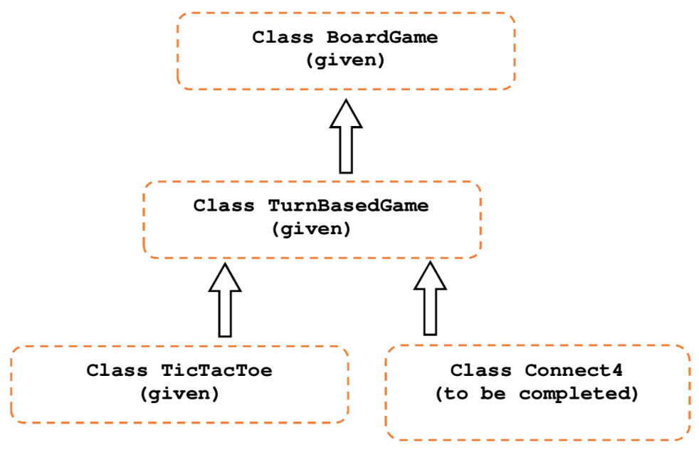
Assignment 6 BoardGame
Build a Connect4 with GUI
Procedure:
Create a new NetBeans project BoardGame with a new class boardgame.Connect4.
Download and copy some given classes into the package folder boardgame.
Complete the class Connect4 which is a subclass of TurnBasedGame.
Right is the given inheritance hierarchy. All four classes are "main" classes, i.e., can be run.

Slide 7
Assignment 6 BoardGame
Build a Connect4 with GUI
Hints:
First of all, leave your newly created class Connect4 alone. Run all other three given classes one-by-one. Try to enjoy and understand their behaviours and the coordinates systems.
Read the given source code files. TicTacToe is a good reference for you to begin with.
Remember that due to inheritance, subclasses can enjoy most of the features, fields and methods of their super classes. Subclasses may also override some of the inherited methods. Subclasses may also introduce new fields and methods.
If you have many opened projects, close others or click menu [Run] -> [Set Menu Project]. You shall set Connect4 as the Main class of the project.

Slide 8
OOP Understanding
Question 4A - Please study the 3 Java classes Robot, FlyingRobot & SmartRobot, and please write down the output of the program:
public class Robot {
protected int energy;
protected String name;
public Robot(int e, String n) {
this.energy = e;
this.name = n;
}
public void move() {
System.out.println("Walk");
energy -= 5;
}
public void charge(int e) {
energy += e;
System.out.println("Super charged: " + energy);
}
} // ... next page

Slide 9
OOP Understanding
public class FlyingRobot extends Robot {
public FlyingRobot(int e, String n) {
super(e,n);
}
public void move() {
System.out.println("Fly");
energy -= 10;
}
public void charge(int e) {
e = e/2;
System.out.print("Flying uses ");
super.charge(e);
}
} // ... next page

Slide 10
OOP Understanding
public class RobotDemo {
public static void main(String[] args) {
Robot[] robots = new Robot[4];
Robot r = new Robot(20, "R1");
robots[0] = robots[1] = r;
robots[2] = new FlyingRobot(20, "F1");
robots[3] = new SmartRobot(20, "S1", "Java");
for (int i=0; i<robots.length;i++) {
robots[i].move();
robots[i].charge(15);
}
// <part B statements go here> ... ignore them for part A
} // ... next page

Slide 11
OOP Understanding
Proposed solution :
run:
Walk
Super charged: 30
Walk
Super charged: 40
Fly
Flying uses Super charged: 17
Fly
Smart Charged: 25

Slide 12
OOP Understanding
Question 4B - Imagine if we run the following statements
after part A statements. Please identify if the statements
are correct or not, if you think they are incorrect, please state
whether they are "Runtime Error" or "Compilation Error".
Statements | Correct?(Y/N) | Error Type
FlyingRobot ref_F = robots[1];
((SmartRobot)robots[3]).program()
Robot ref_R = (FlyingRobot)robots[0];

Slide 13
OOP Understanding
Question 4B - Imagine if we run the following statements
after part A statements. Please identify if the statements
are correct or not, if you think they are incorrect, please state
whether they are "Runtime Error" or "Compilation Error".
Statements | Correct?(Y/N) | Error Type
FlyingRobot ref_F = robots[1]; | N | Compilation
((SmartRobot)robots[3]).program() | Y | N/A
Robot ref_R = (FlyingRobot)robots[0]; | N | Runtime

Slide 14
Array and Reference
Question 5A - Based on the given Matrix class below, define a method subMatrixSum() which computes and returns the sum of all elements in a sub-matrix, indexed by rowS: first row of extract, colS: first column to extract, nRow: no. of rows and nCol: no. of columns
public class Matrix {
protected int m, n;
protected double[][] cell;
public Matrix(int row, int col) {
m = row; n = col;
cell = new double[m][n];
}
public double subMatrixSum(int rowS, int colS, int nRow, int nCol) {
// Your implementation here
}
}
1.0 | 2.0 | 2.0 | 3.0
-2.0 | 3.0 | 4.0 | 5.0
1.0 | 0.0 | 1.0 | 8.0
0.0 | 1.0 | 1.0 | 8.0
2.0 | -1.0 | 2.0 | 5.0
Example:
subMatrixSum(0,1,4,2)=14.0

Slide 15
Array and Reference
Question 5A - Based on the given Matrix class below, define a method subMatrixSum() which computes and returns the sum of all elements in a sub-matrix, indexed by rowS: first row of extract, colS: first column to extract, nRow: no. of rows and nCol: no. of columns
Proposed solution :
public double subMatrixSum(int rowS, int nRow, int colS, int nCol) {
double sum = 0;
for ( int r = rowS; r < rowS + nRow; r++ ) {
for ( int c = colS; c < colS + nCol; c++ ) {
sum += cell[r][c];
}
}
return sum;
}

Slide 16
Array and Reference
A programmer wants to flip a matrix upside down quickly using references and has coded the following program but it does not work.
Question 5B - Explain why his program fails.
Question 5C - Rewrite a fix for him using References.
int [][] a = new int[][] {{1,2,3,4},{5,6,7,8},{9,10,11,12},{13,14,15,16}};
int [][] s = a;
for ( int r = 0; r < 4; r++ ) a[r] = s[3-r];
for ( int r = 0; r < 4; r++ ) {
for ( int c = 0; c < 4; c++ ) {
System.out.printf("%d ", a[r][c]);
}
System.out.println();
}
run:
13 14 15 16
9 10 11 12
9 10 11 12
13 14 15 16

Slide 17
Array and Reference
Proposed Answer 5B : The programmer mistakenly assumed that variable s would be able to access the rows of a independently but variable s is by definition just an alias of variable a.
Proposed solution 5C ver. 1 :
int [][] a = new int[][] {{1,2,3,4},{5,6,7,8},{9,10,11,12},{13,14,15,16}};
int [][] s = new int[4][];
for ( int r = 0; r < 4; r++ ) s[r] = a[r];
for ( int r = 0; r < 4; r++ ) a[r] = s[3-r];
for ( int r = 0; r < 4; r++ ) {
for ( int c = 0; c < 4; c++ ) {
System.out.printf("%d ", a[r][c]);
}
System.out.println();
}
run:
13 14 15 16
9 10 11 12
5 6 7 8
1 2 3 4

Slide 18
Proposed solution 5C ver. 2:
int [][] a = new int[][] {{1,2,3,4},{5,6,7,8},{9,10,11,12},{13,14,15,16}};
for ( int r = 0; r < 4/2; r++ ) {
int [] s = a[r];
a[r] = a[3-r];
a[3-r] = s;
}
for ( int r = 0; r < 4; r++ ) {
for ( int c = 0; c < 4; c++ ) {
System.out.printf("%d ", a[r][c]);
}
System.out.println();
}
run:
13 14 15 16
9 10 11 12
5 6 7 8
1 2 3 4

Slide 19
END

